Slide 1
My first website Web tech I project
Submitted by :-
Amir Maharjan

Slide 2
Division one :
Division One is the top-most part.
Motto of Shahid Smarak college.
Consists of Contact number, Email and Social media platforms.

Slide 3
Division Two :
Logo
Established Data
Affiliation

Slide 4
Division Three :
The Navigation Bar.
The most important feature in a website.
Objective -> simplicity

Slide 5
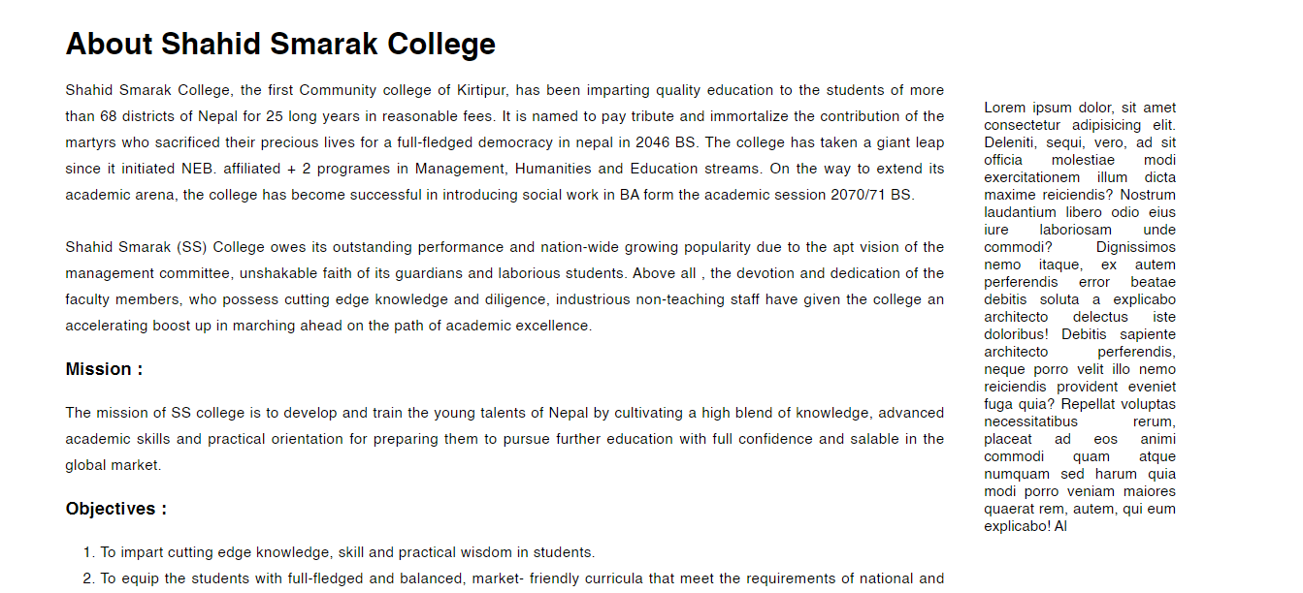
Division Four :

Slide 6
Using <div>, created row.
Created 2 columns in that row.
In the 1st columns, a brief summary of Shahid Smarak College along with its missions and objectives are mentioned.
In the 2nd column, it’s a space for advertisement and a shortcut for notices.

Slide 7
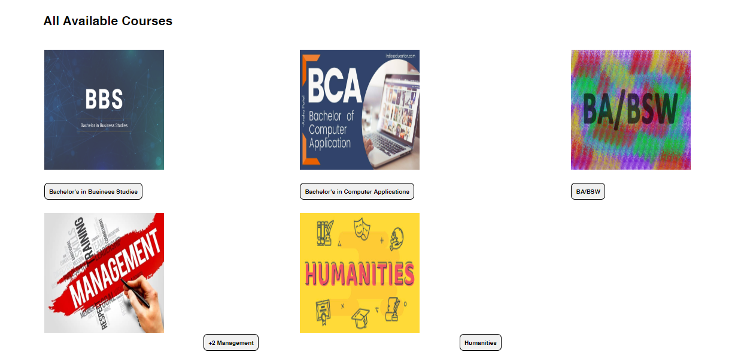
Division Five :

Slide 8
Inside Division five, created a table.
In the 1st row, created 3 columns.
In the 2nd row, created another 2 columns.
Inside each column, placed an <img> and <button> tag.

Slide 9
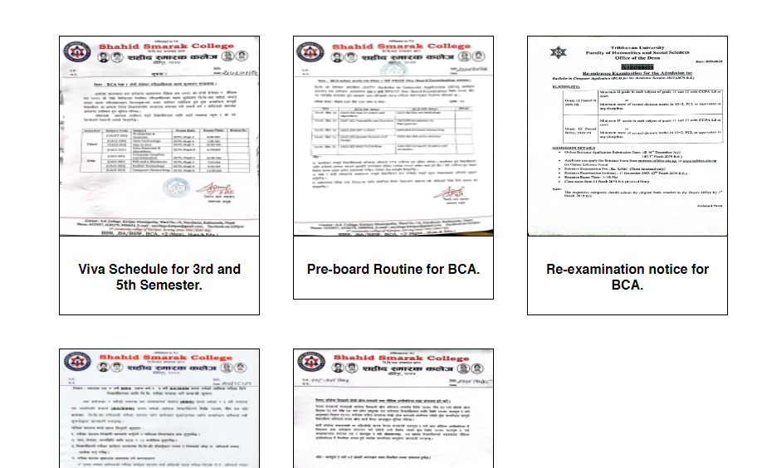
Division Six :

Slide 10
The division six is created using <div> tags, all having the same class.
Inside the <div> tag, <a> , <img> and <p> are used to display the notices.
CSS is used to bring out the border lines.

Slide 11
Division seven :

Slide 13
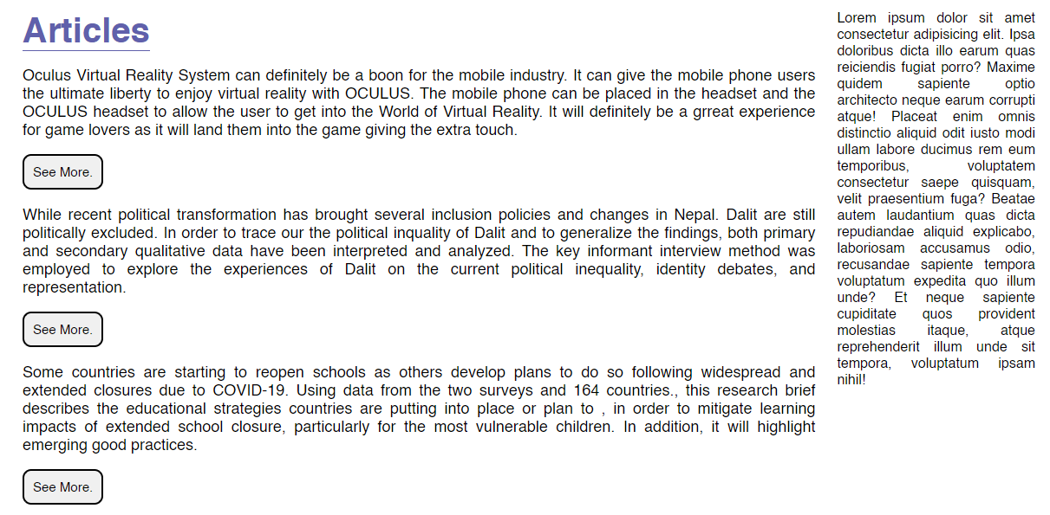
Division EIGHT :

Slide 14
In division eight, columns are created in the same way as in division four.
<h1> tag is used for heading.
<p> is used for sub-heading.
Multiple <div> tags. In each, a <p> and <button> tag is inserted

Slide 15

Division Nine :

Slide 16
<h1> is used for heading.
An <ol> tag is used to listing.
An <a> is used to make the links clickable and send the user to the designated location.

Slide 17
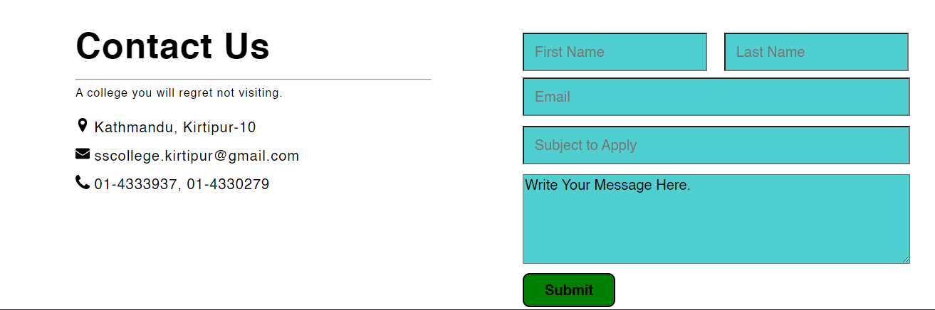
Division ten :

Slide 18
Two columns are created using the same method.
For heading <h1> is used.
<hr> tag is used to insert a single line.
<text> and <img> is used to write contact details and insert a icon in column 1.
In column 2, a <form> is created with the help of <table> tag.

Slide 19
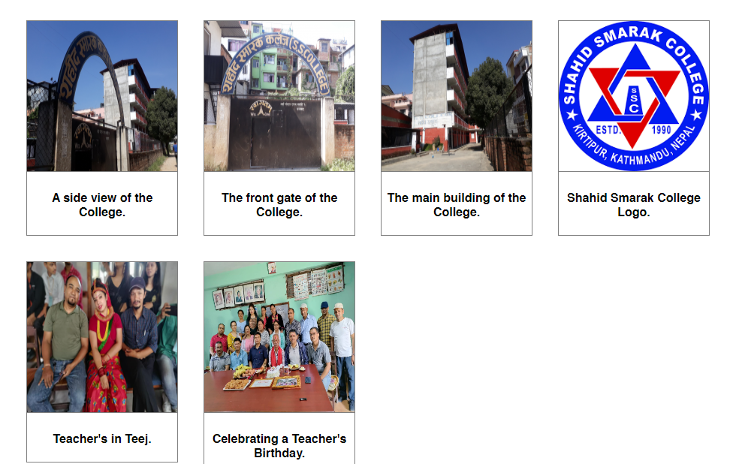
Division Eleven :

Slide 20
Division Eleven is created in the same way division six was created.
<div>,<img>,<p>, etc. tags are used.
Division six and Division eleven are almost similar except with some minor changes.

Slide 21
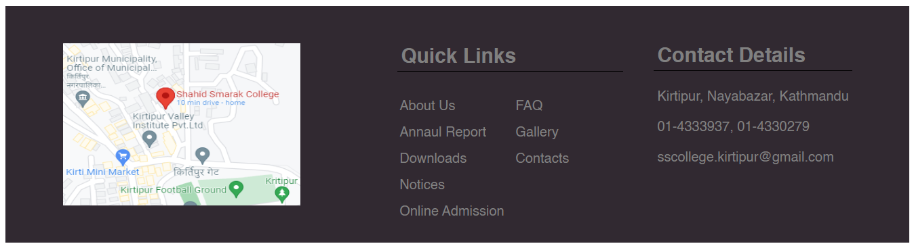
Division footer :

Slide 22
The height and width of the division is set using CSS.
Division Footer is divided into 3 columns using the same method as before.
In the 1st column, <a> and <img> tags are used to insert an image and when clicked, sends user to google maps that shows the location of the college.
In the 2nd column, <table> tag is used to insert 5 rows and 2 columns.
In the 3rd column, <h1> and <p> tags are used.

Slide 23
Finally :
Division one, two, three and footer are used in every other division.
After putting together everything, this is how it looks.
NOTE: host it using xampp.

Slide 24
Reference :
Shahid Smarak College Official website. (www.sscollegekirtipur.edu.np).
Janamaitri Multiple Campus Official website. (www.janamaitri.edu.np).

Slide 25
The end.

